Slide 1
Chili Leaf Health Classification
Anas mukhtar
su92-msaiw-f25-022
Muhammad waleed Iqbal
su92-msdsw-f25-023
Superior university gold campus

Slide 2
Introduction
Agriculture forms the backbone of global food security and economic stability, with vegetable production playing a vital role in nutrition and commerce. Among vegetables, chili peppers (Capsicum species) hold particular significance due to their widespread cultivation, culinary importance, and economic value in both domestic and international markets. The quality of chili peppers directly impacts their market value, consumer acceptance, and suitability for food processing applications.
• Early detection improves yield
• Manual inspection is time-consuming
• Deep Learning provides automated solution

Slide 3
Objective
• Classify chili as Healthy or Unhealthy
• Use image-based deep learning model
• Achieve reliable and practical accuracy

Slide 4
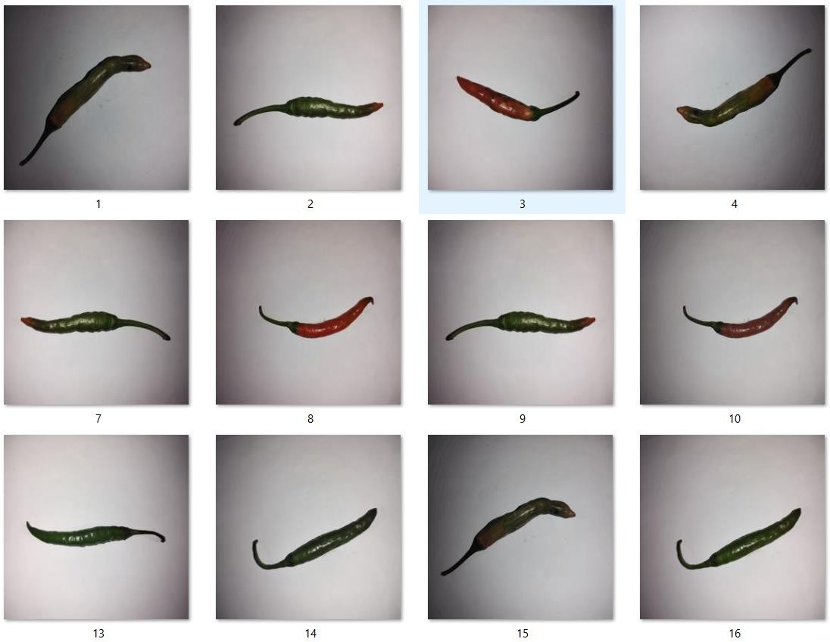
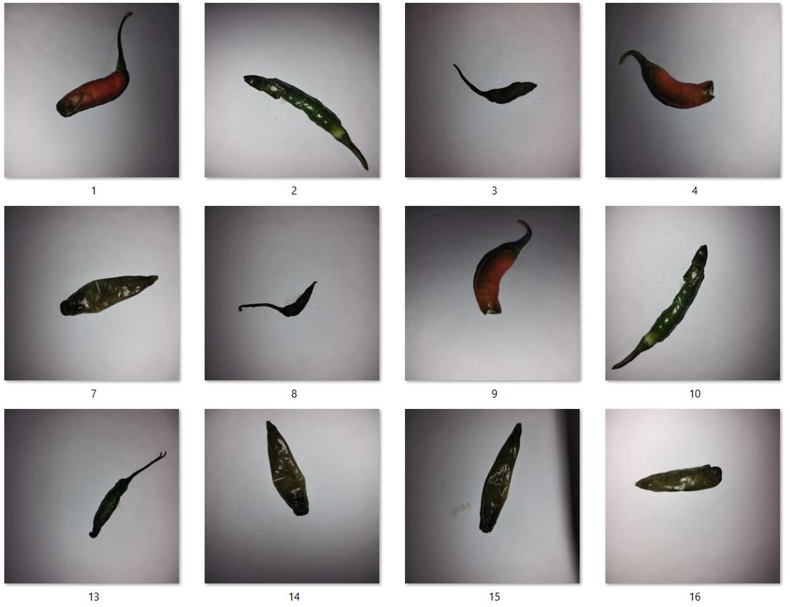
Dataset
• Images of chili
• Two classes: Healthy and Unhealthy
• Data split into training and validation sets

Slide 5
Methodology
Image preprocessing and augmentation
• MobileNetV2 pretrained model
• Transfer learning and fine-tuning

Slide 6
Model Architecture
MobileNetV2 as base model
• Dense layers with Dropout
• Sigmoid activation for binary classification

Slide 7
Training Process
. Phase 1: Train top layers
• Phase 2: Fine-tuning
• Optimizer: Adam
• Loss: Binary Crossentropy

Slide 8
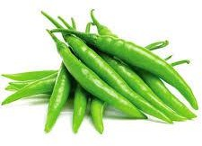
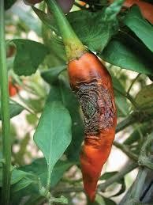
Results
• Good classification performance
• Reduced false predictions
• Evaluated using Accuracy and AUC
    RESULT: healthy
    CONFIDENCE: 60.46%
    RESULT: unhealthy
    CONFIDENCE: 50.01%

Slide 9
Conclusion
• Automated chili classification achieved
• Deep learning effective for agriculture
• System helps farmers

Slide 10
Future Work
• Increase dataset size
• Multi-disease classification
• Mobile application development

Slide 11
Thank You

